Slide 1



Slide 2


Home
Avengers
Profile here
Agents
Coulson
Skye
May
Simmons
Fitz

Slide 3
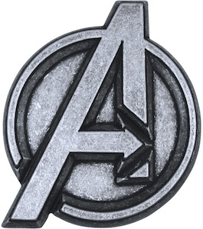
Home
Shield
Profile here
Members
Iron Man
Captain America
Thor
Hulk
Black Widow
Hawkeye

